Slide 1
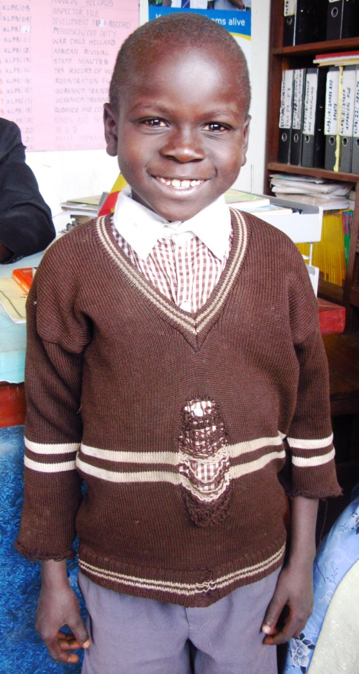

A Day In The Life of Elvis

Slide 2
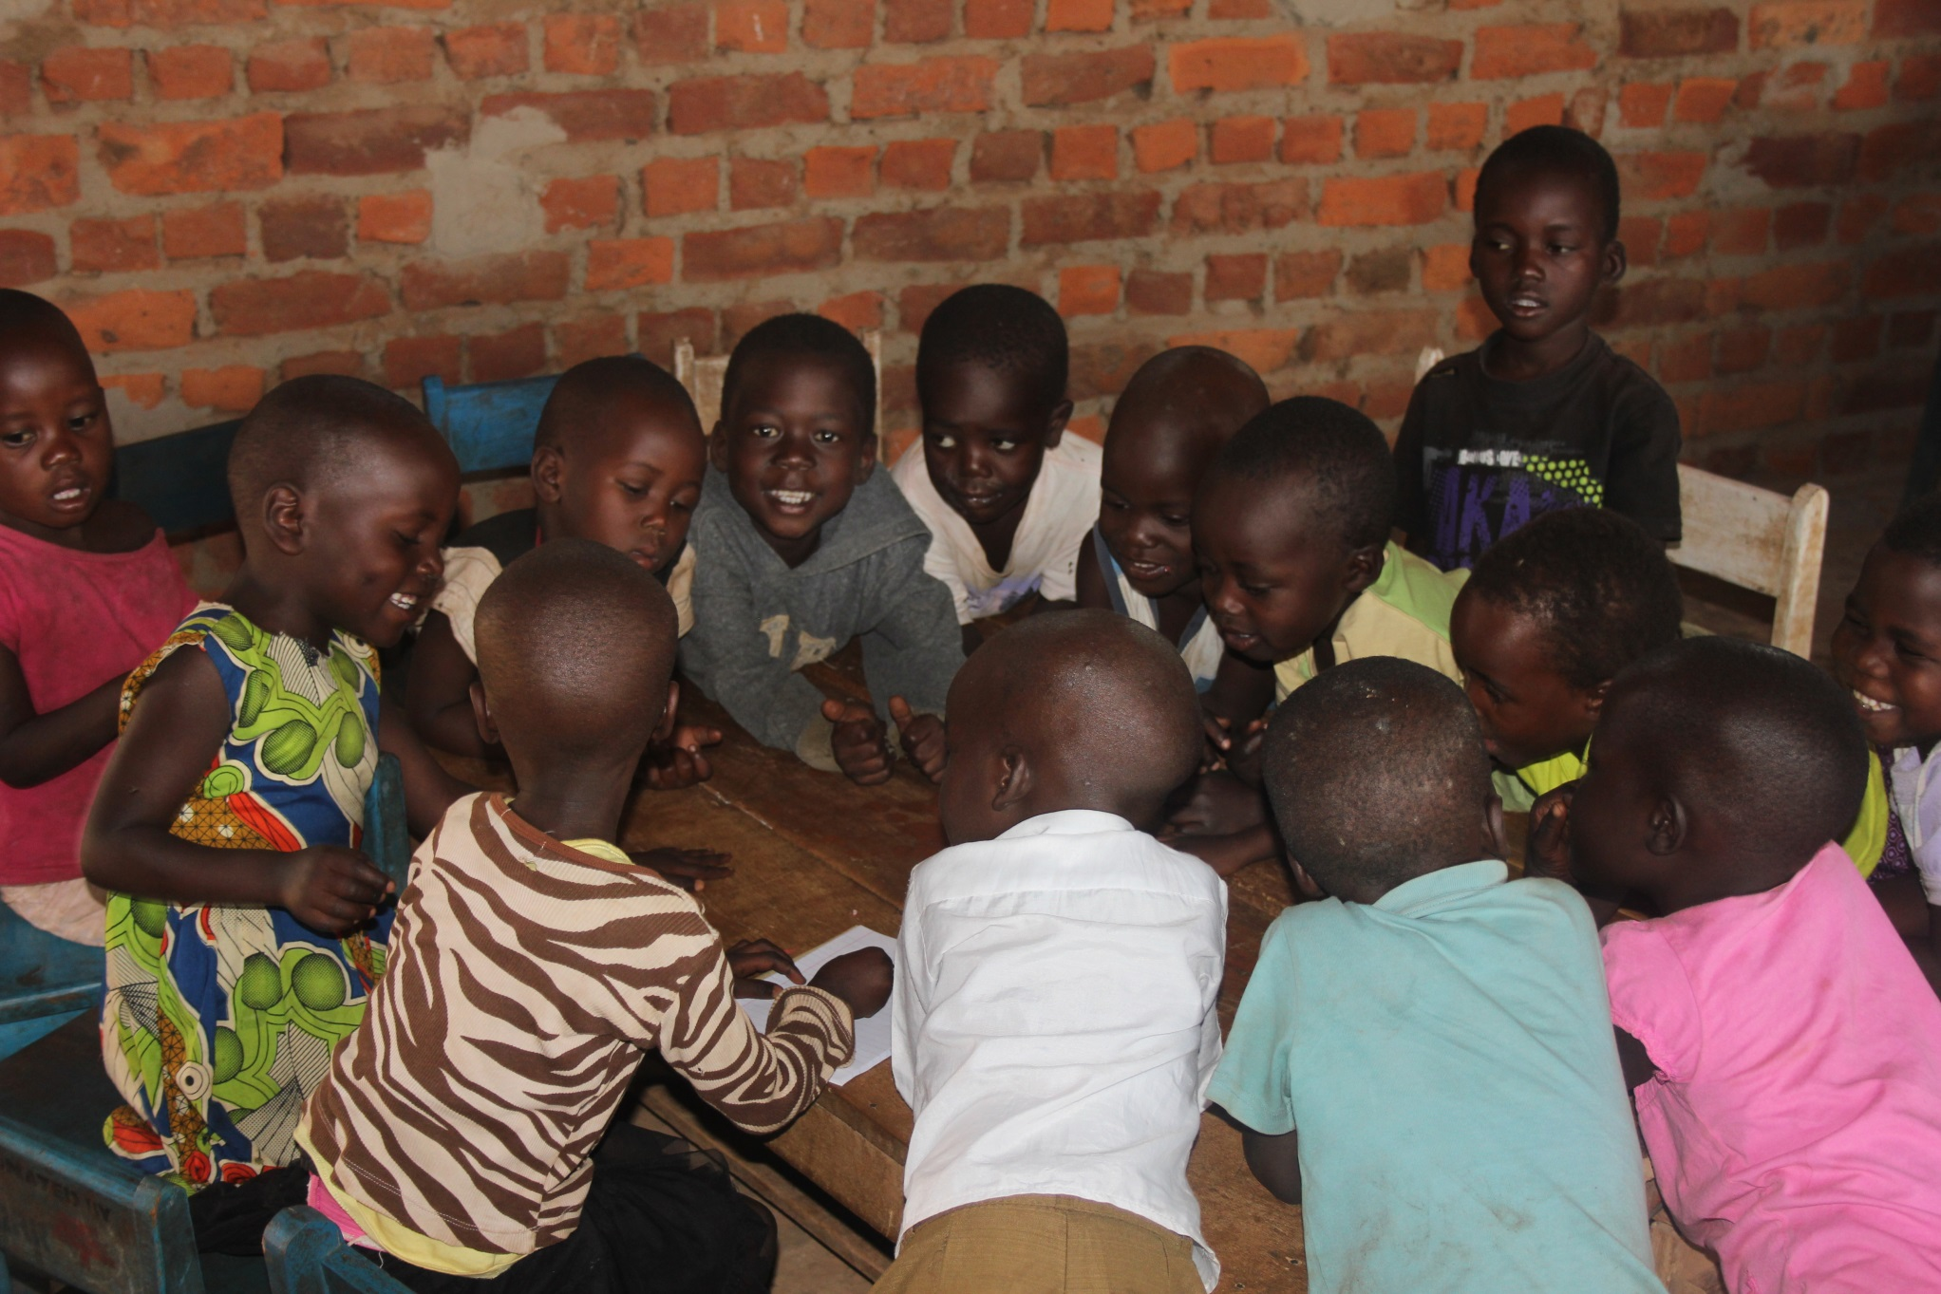

Slide 3
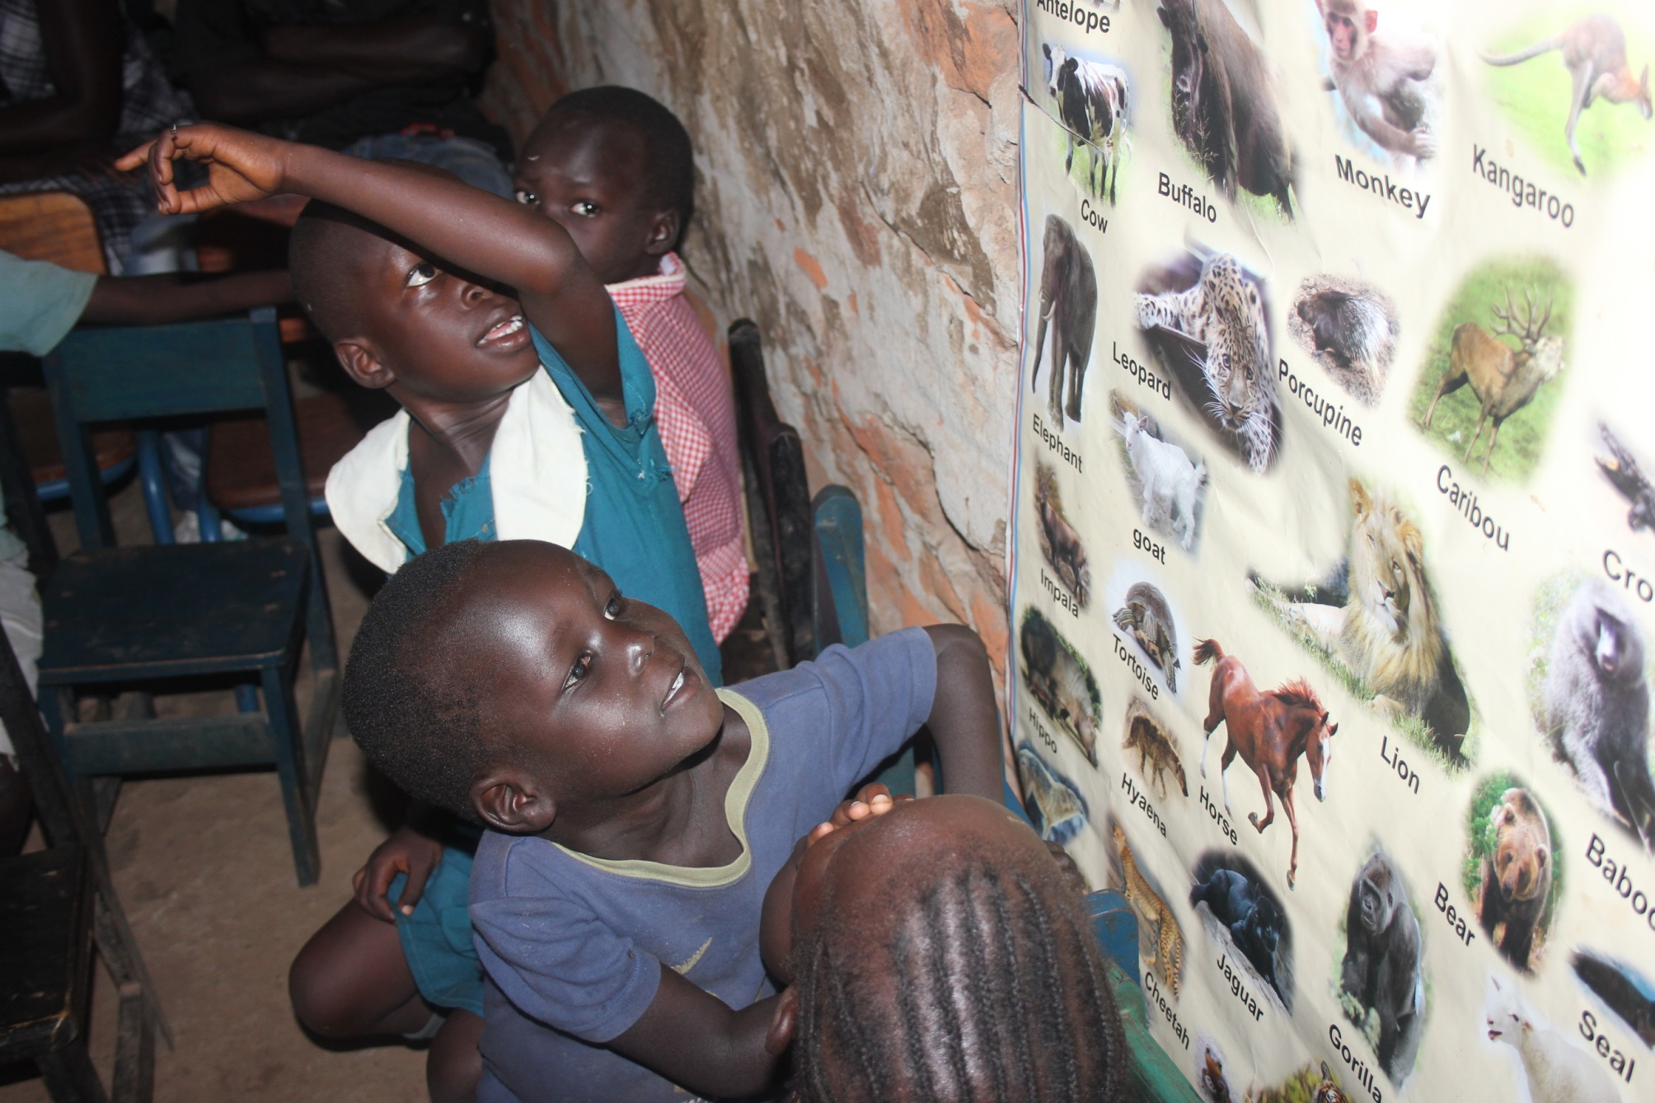

Slide 4
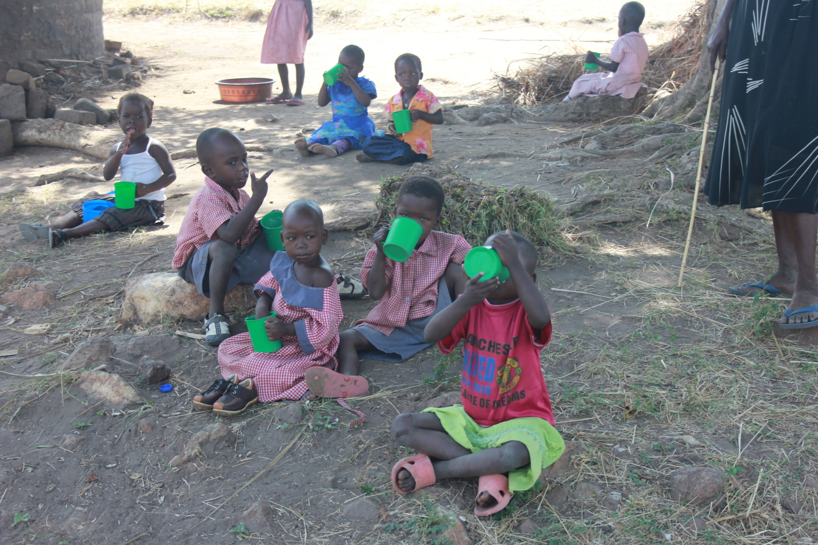

Slide 5
True or False?
Students in Uganda…
Will not usually have any food at school

Slide 6
True or False?
Students in Uganda…
Don’t do writing and drawing at school

Slide 7
True or False?
Students in Uganda…
Sometimes go to nursery school before primary school

Slide 8
True or False?
Students in Uganda…
All want to be farmers when they grow up

Slide 9
True or False?
Students in Uganda…
Sometimes love to go to school!

